Slide 1
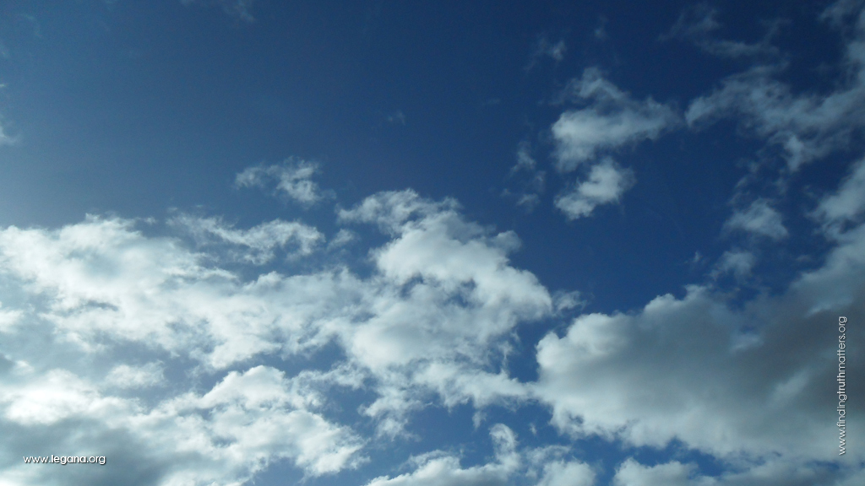
“Great is our Lord and worthy of our praise” Psalm 48:1

Slide 2
What Jesus Said Of Our Greatest Possession
Mark 8:36,37; Matthew 16:24-27
Free Powerpoint Templates

Slide 3
This story has circulated in religious periodicals: “Around 200 years ago, the tomb of Charlemagne, was opened. His body, sitting upright, clothed with royal garments, and a scepter in his bony hand. On his knees lay the Holy Scriptures, with a lifeless, bony finger pointing to Mark 8:36: “For what shall it profit a man, if he shall gain the whole world, and lose his own soul?” (Unknown Source)
Charlemagne
(Charles the Great): 742-814
King of France

Slide 4
Intro:
Perhaps the Emperor Charlemange recognized the value of one’s soul, more so than the power and riches he possessed – We may never know his true intentions
However, we do know that:
- Man has a soul
- This soul is of great value
- This soul is eternal and,
- This soul may be lost
3. What is this we call « soul »?
4. In the Bible, this word (soul) has several uses:
(1) When refering to a person (Ex. 1:5; Acts 2:41)
(2) When refering to physical life (Gen. 1:20, 21, 30)
(3) When refering to feelings, emotions (Acts 4:32)
(4) When refering to the inner man, the spirit, the immortal part of man – This is the application of this verse
Mark 8:36,37; Matthew 16:24-27

Slide 5
What Jesus Said Concerning Greatest Possession …
Our Soul Is More Valuable Than
The Whole World
Because it is made in the image of God
-- Created this way, Gen. 1:26,27
-- God does not have physical body like us, Jn. 4:24
-- Our soul, (inner person, spirit) is made in the image of God
-- Our soul is what helps us understand life, death, eternity – helps us reason, distinguish good from evil, our sense of morality, justice, love, hate, etc.
Mark 8:36,37; Matthew 16:24-27

Slide 6
What Jesus Said Concerning Our Greatest Possession…
Our Soul Is More Valuable Than
The Whole World
Because it is made in the image of God
Because we have control over it
-- We can control attitudes, thoughts, personality, the way we live (Rom. 12:1,2; Col. 3:12-15)
-- Soul is renewed day by day, ”but though our outward man perish, yet the inward man is renewed day by day” (2 Cor. 4:16)
Mark 8:36,37; Matthew 16:24-27

Slide 7
What Jesus Said Concerning Our Greatest Possession…
Our Soul Is More Valuable Than
The Whole World
Because it is made in the image of God
Because we have control over it
Because it lives forever
-- Our bodies die, return to dust
-- Our Soul does not die, returns to God (Gen. 3:19; Ecc. 12:7)
-- Our soul needs to be right with God, how we live will determine our eternity, Ps. 90:10; 2 Cor 5.10
-- « Is it well with my soul »
Mark 8:36,37; Matthew 16:24-27

Slide 8
What Jesus Said Concerning Our Greatest Possession…
Our Soul Is More Valuable Than
The Whole World
Because it is made in the image of God
Because we have control over it
Because it lives forever
Because Jesus gave his life for it
-- Soul destined for punishment, due to sin
-- Christ shed his blood to save us, « ye were not redeemed with corruptible things, as silver and gold, from your vain conversation received by tradition from your fathers; But with the precious blood of Christ, as of a lamb without blemish and without spot”

Slide 9
1. Our Soul Is More Valuable Than Whole World
2. Our Soul Is Not A Bargaining Tool,
« Not For Sale »
Jesus is speaking of gains and losses, he uses the words «gain, profit, exchange » we can make a bad « deal » where we lose our soul
INCALCULABLE –more than the whole world!
IRREPLACEABLE – should soul be lost, it cannot be replaced like some things in life
UNFORGIVEABLE – having lost our soul and we die in that condition, do we expect to be forgiven?
Will we sell our soul for « X »?
X = riches, pleasures, fame,
Heb. 12:15-17

Slide 10
1. Our Soul Is More Valuable Than World
2. Our Soul Is Not A Bargaining Tool
Our Soul Is Lost Based On Our Rejection of Jesus; Saved Upon Our Acceptance Of Him
-- Notice: « whosoever will come after me… » Vs. 34
-- Notice: « whosoever therefore be ashamed of me » Vs. 38 (Mark 8)
-- Notice: « and is not rich toward God » Speaking of the parable of the « foolish » rich man

Slide 11
“And he spake a parable unto them, saying, The ground of a certain rich man brought forth plentifully:
Luk 12:17 And he thought within himself, saying, What shall I do, because I have no room where to bestow my fruits? And he said, This will I do: I will pull down my barns, and build greater; and there will I bestow all my fruits and my goods. And I will say to my soul, Soul, thou hast much goods laid up for many years; take thine ease, eat, drink, and be merry. But God said unto him, Thou fool, this night thy soul shall be required of thee: then whose shall those things be, which thou hast provided? So is he that layeth up treasure for himself, and is not rich toward God.” Luke 12:16-21

Slide 12
1. Our Soul Is More Valuable Than World
2. Our Soul Is Not A Bargaining Tool
Our Soul Is Lost Based On Our Rejection of Jesus; Saved Upon Our Acceptance Of Him
-- Notice: « whosoever will come after me… » Vs. 34
-- Notice: « whosoever therefore be ashamed of me » Vs. 38 (Mark 8)
-- Notice: « and is not rich toward God » Speaking of the parable of the « foolish » rich man
* Foolish for living a selfish life
* Foolish for forgetting that life is uncertain
* Foolish for providing for flesh not his soul

Slide 13
What Jesus Said Concerning Our Greatest Possession…
1. Our Soul Is More Valuable Than World
2. Our Soul Is Not A Bargaining Tool
Our Soul Is Lost Based On Our Rejection of Jesus; Saved Upon Our Acceptance Of Him
Finally: Is it well with your soul?
If you are not in Christ, your soul is not well – save your soul,
come to Christ today!

